Slide 1
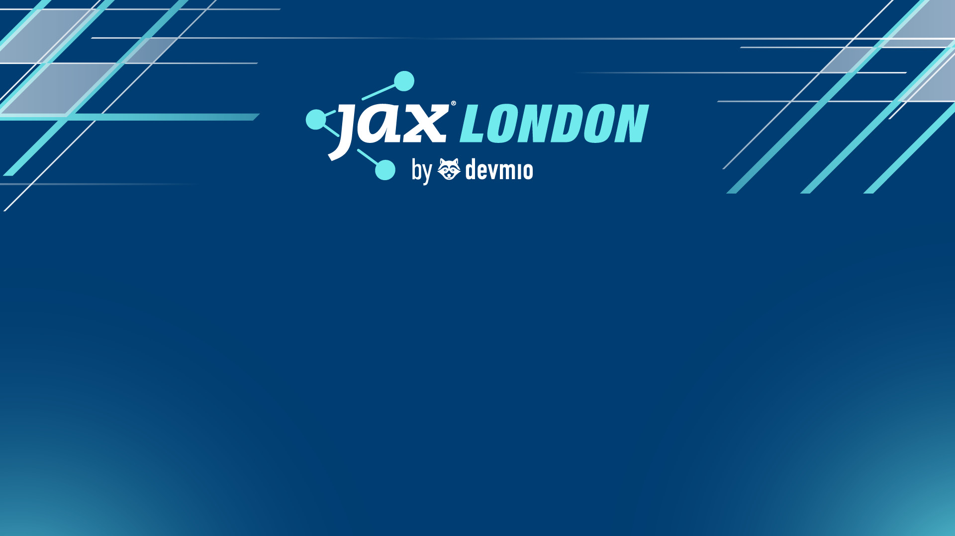
Cultivating GPT Culture
Unleashing AI Productivity with a Company Toolkit
Roberto Freato | CTO @Retex – Azure MVP - Author

Slide 3
20 years of (some) innovations
Internet of Things (2012-2020)
Quantum Computing (2010-2022)
Big Data Analytics (2010-2018)
Blockchain & Crypto (2008-2020)
Smartphones (2007-2015)
Cloud Computing (2006-2015)
Social Media Platforms (2004-2012)
2004
2009
2014
2019
2024

Slide 4
20 years of (some) innovations
GenAI (2022-)
Internet of Things (2012-2020)
Quantum Computing (2010-2022)
Big Data Analytics (2010-2018)
Blockchain & Crypto (2008-2020)
Smartphones (2007-2015)
Cloud Computing (2006-2015)
Social Media Platforms (2004-2012)
2004
2009
2014
2019
2024

Slide 6
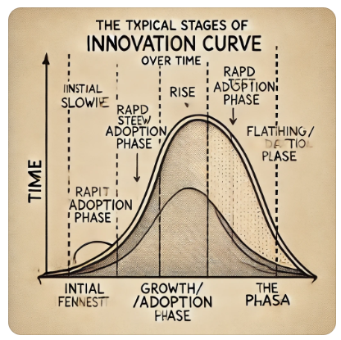
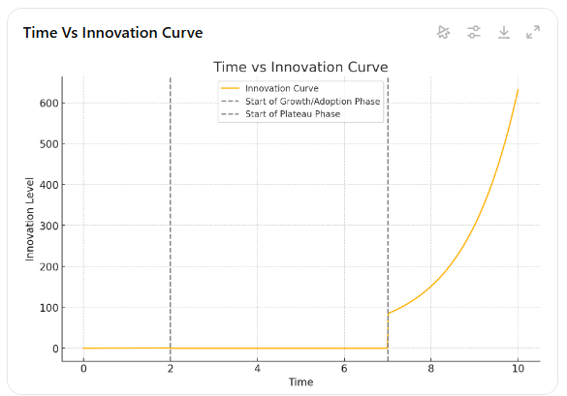
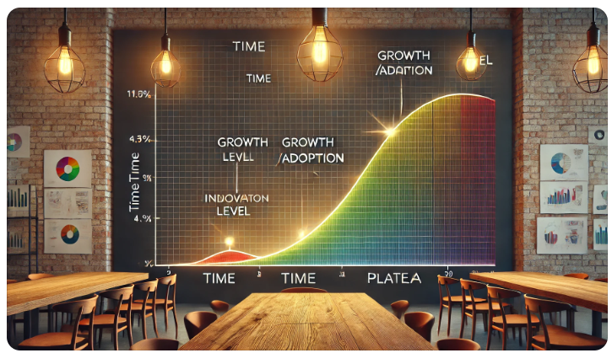
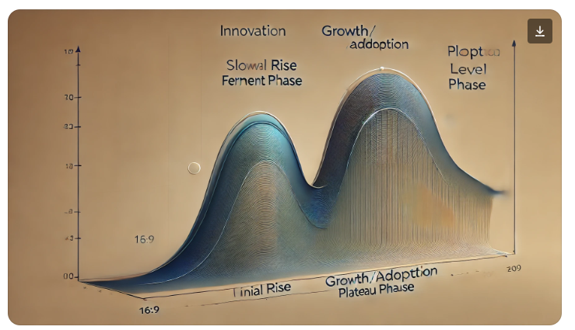

Slide 7
Smartphones (2007-2015) ~ 9 years
2012
Cloud Computing (2006-2015) ~ 10 years
2013
GenAI (2022-2024) ~ 2 years
2025-2026?

Slide 8
“The Ring AI grants the bearer a power that is proportional to the one they already have”
J. R. R. Tolkien
Me
* This statement is based on real research that suggests AI can amplify both positive and negative outcomes. However, I do not have the rights to share it here.

Slide 9
“Gen AI is, for most of us, what Excel was for accountants in the 90s”
* This statement is based on nothing

Slide 10
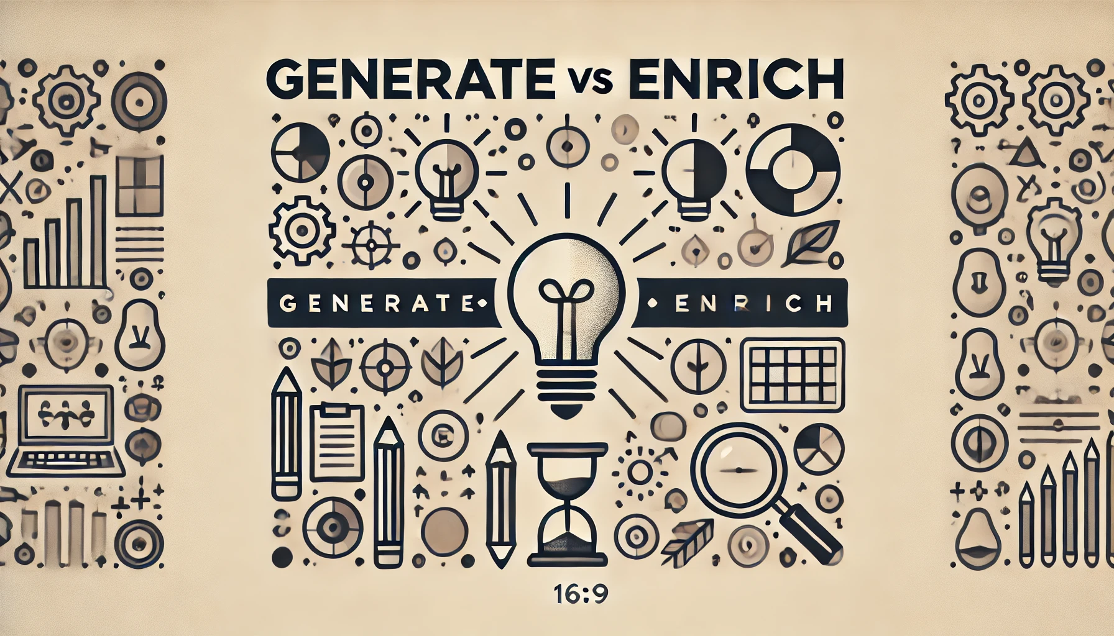

Slide 11
Statement
With Generative AI, we shouldn't strain ourselves trying to figure out how to package and sell it as a product—this has been a common mistake over the past year and a half. Instead, we need to become its primary users as quickly and as widely as possible. The more we integrate it into our daily work—just like we use Excel, smartphones, or even a desk and a mouse—the more naturally the right ideas for new offers and products will emerge. These innovations may not necessarily revolve around AI itself, but without it, they might never come to life.

Slide 12
Proposal

Slide 13

Empower
by democratize technology

Slide 14
Let’s give GenAI to every colleague
Challenges
Costs:
current price point for a user/month for a GenAI tool is 10-40$/m
Vendor lock-in:
with this speed, who’s the market leader, 6 months from now?
Security:
does the paid solution provide 100% safety and privacy to our data?
Control:
can we shape the service features to both address results and evangelization?

Slide 15
The tech part

Slide 16
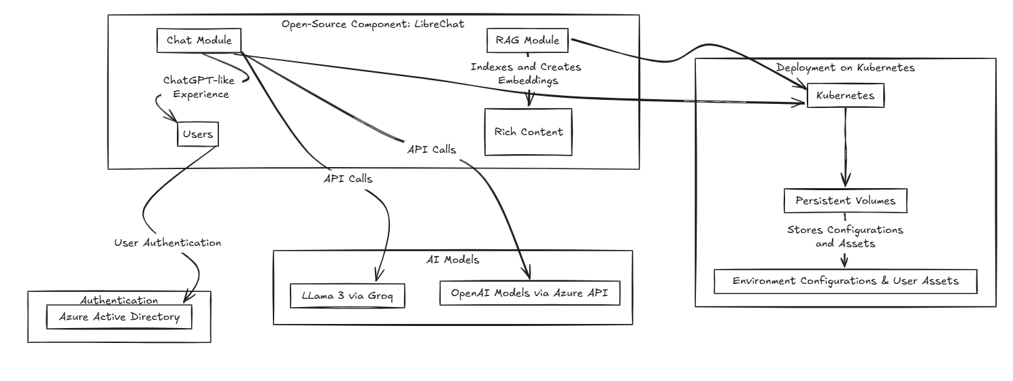

Slide 17
DEMO
Basic generation, Prompt libraries, Settings, RAG, Models comparison
Notes:
Recap the file
I'm attaching a file and you read it. I want you to help me understanding the contents by summarizing it.
I want the result as {{style: bullets, sentences}}. If you ask me if use some bold/italic/underline styles to emphasize? I would say {{emphasis: yes , no}}.
Use {{language}} for the output.
Be {{lenght: short, wordy, verbose}}.

Slide 18


Slide 19
compute quadrant (2022)
Container Apps
Notes:
Budget – 5min
How to read this quadrant and how’s made
Information is accurate but personal
Scale may depends on soft or hard limits of the platform
Examples of soft and hard limits
Ease of management can be the degree of interest we need to have to the underlying infrastructure
Or either the lock-in aspect
Or the industry-standard adherence

Slide 20
compute quadrant (now)
Container Apps
Notes:
Budget – 5min
How to read this quadrant and how’s made
Information is accurate but personal
Scale may depends on soft or hard limits of the platform
Examples of soft and hard limits
Ease of management can be the degree of interest we need to have to the underlying infrastructure
Or either the lock-in aspect
Or the industry-standard adherence

Slide 21
From K8s to Azure Container Apps
Kubernetes
Need to manage despite it’s PaaS
Container Instances
The low-level serverless unit to run containers
Good to handle spikes of AKS or custom jobs
Container Apps
It’s a serverless container solution with steroids
(with some constraints) Can replace K8s
Need to know the specific artifacts
Overall TCO could be higher
Need to build your own governance process
It implements (but hides) many K8s features

Slide 22
DEMO
Container Apps

Slide 23
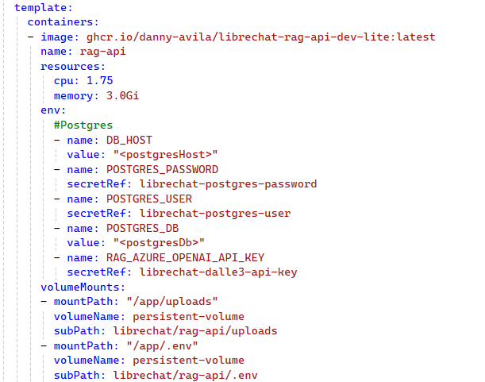
Familiar YAML
Can start from K8s YAML
Name & Image
Resource limits
Env variables
Volume mounts

Slide 24
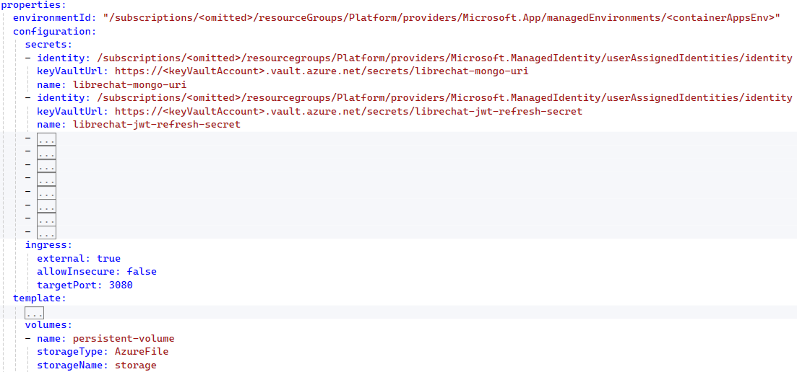
Simplified experience
Secrets management
Ingress configuration
Volume mounting

Slide 25


Slide 26
DEMO
Azure OpenAI experience

Slide 27


Slide 28
Takeaways
«AI at Work» should be the mantra
Start giving instruments, then teach them
Work to align your offering to the market
(nice to have) Choose appropriate technologies to reduce your governance around it

Slide 29
Cultivating GPT Culture
Unleashing AI Productivity with a Company Toolkit
Roberto Freato | CTO @Retex – Azure MVP - Author

